Slide 1

COMP90018
Mobile Computing Systems Programming
WEEK 1 – Introduction, Android Studio, Git
Weiwei Jiang,
weiwei.jiang@student.unimelb.edu.au

Slide 2
About myself
Weiwei Jiang
A PhD student from Human-Computer Interaction group, CIS
Contact: weiwei.jiang@student.unimelb.edu.au

Slide 3
Tutorial Brief
First 6 weeks for introducing Android development.
From Week 7: help with Assignment 2.
Group assignment this week.
  5 / 6 people per group.
  Self sign-up yourself to a group in LMS.
  Otherwise, you will be assigned to a group by next week.
  Only choose Group (tutorial_code)-(group_number)
    All group members must be from the same tutorial.
    e.g., Group-T01/14
tutorial_code
03:15PM Monday | T01/14
04:15PM Monday | T01/06
03:15PM Tuesday | T01/18
04:15PM Tuesday | T01/04

Slide 4
1
Introduction
2
Android Studio
3
Git
CONTENTS

Slide 5

Introduction

Slide 6
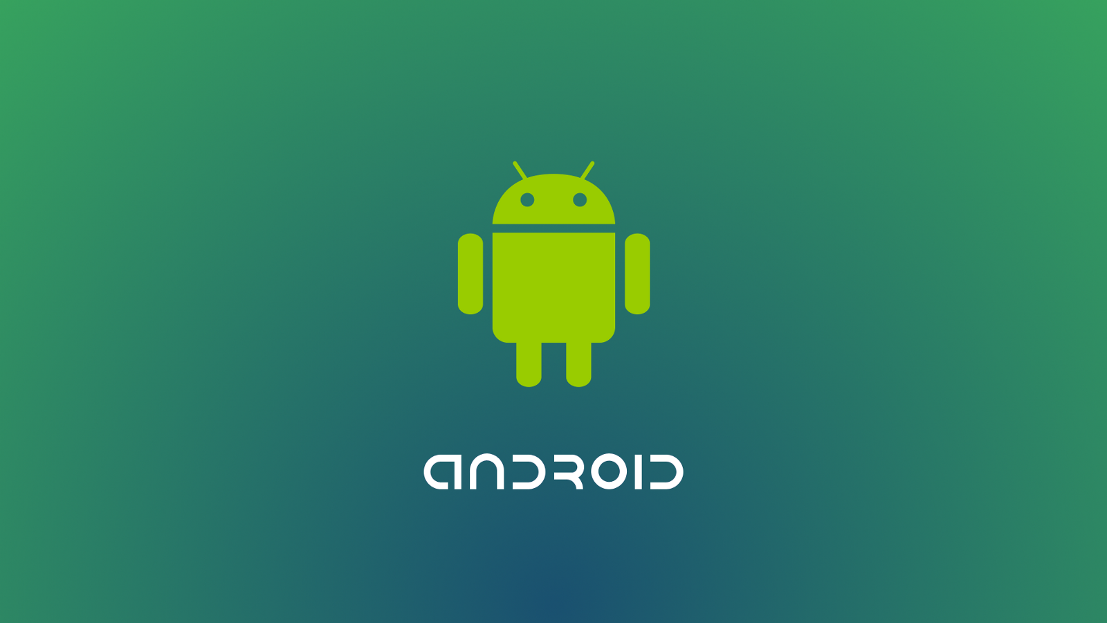
Introduction – Android
A mobile operating system developed by Google;
Based on a modified version of the Linux kernel;
Latest version Android 11 (API level 30);
Android 12 (API level 31) to be released

Slide 7
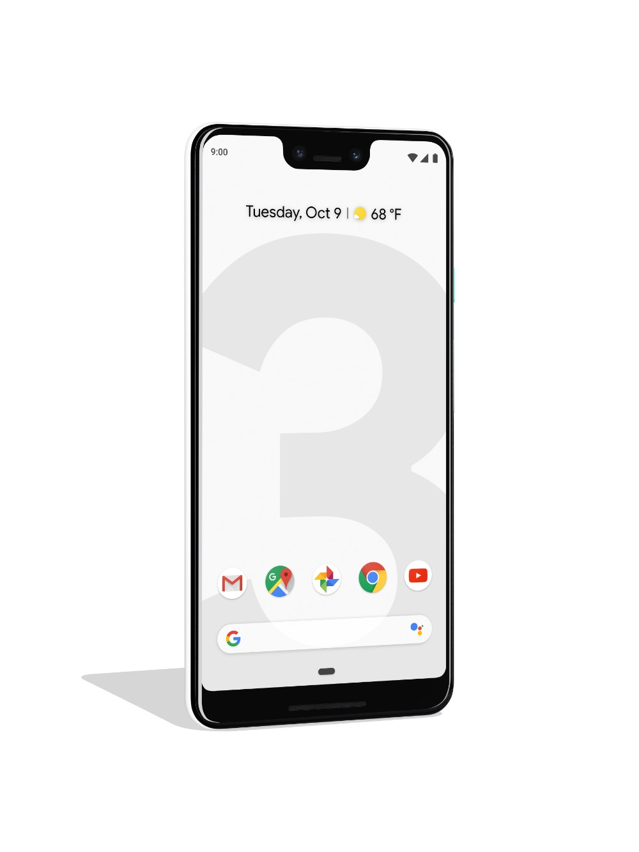
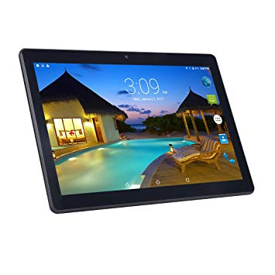
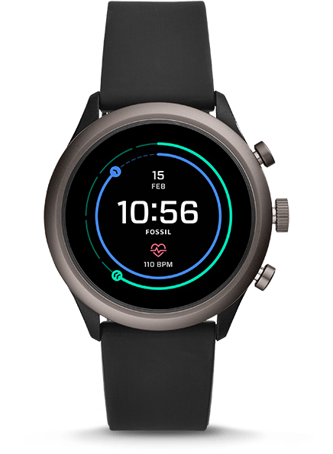
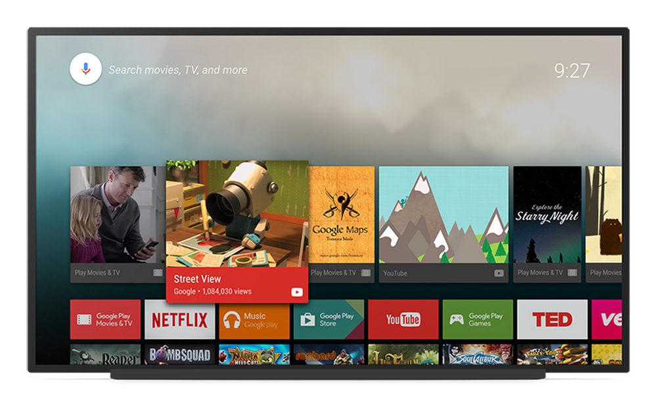
Introduction – Android Platforms
Phone
Watch
Tablet
TV

Slide 8

Introduction – Android Applications
Android apps can be written using Kotlin, Java, C++ and Dart (Flutter UI Framework);
This tutorial uses Java.
The Android SDK tools compile your code along with any data and resource files into an APK (Android package) with an .apk suffix.
From Aug 2021, Google Play requires Android App Bundle (.aab) instead of .apk

Slide 9
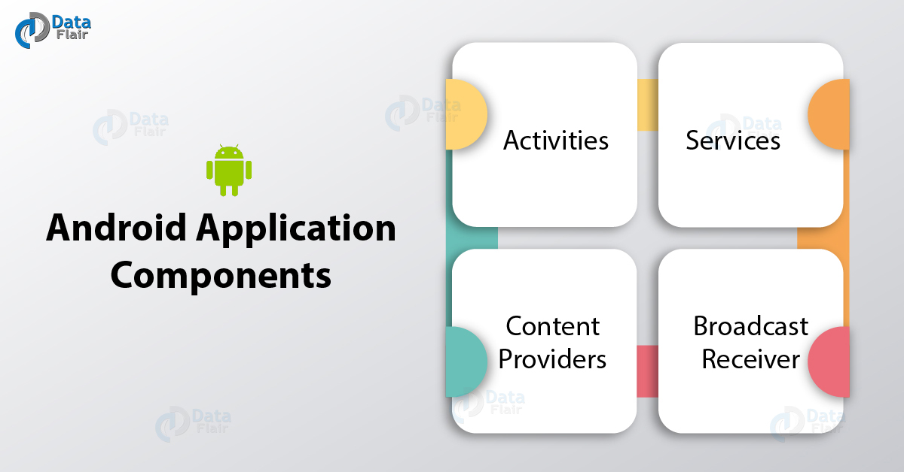
Introduction – Android Applications
https://developer.android.com/guide/components/fundamentals

Slide 10
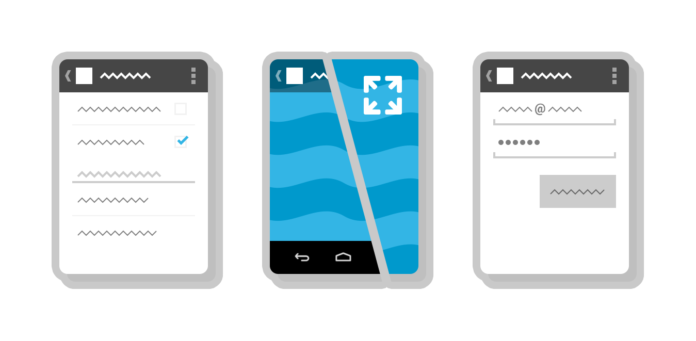
Introduction – Android Application Components
Activities
An activity is the entry point for interacting with the user. It represents a single screen with a user interface.

Slide 11
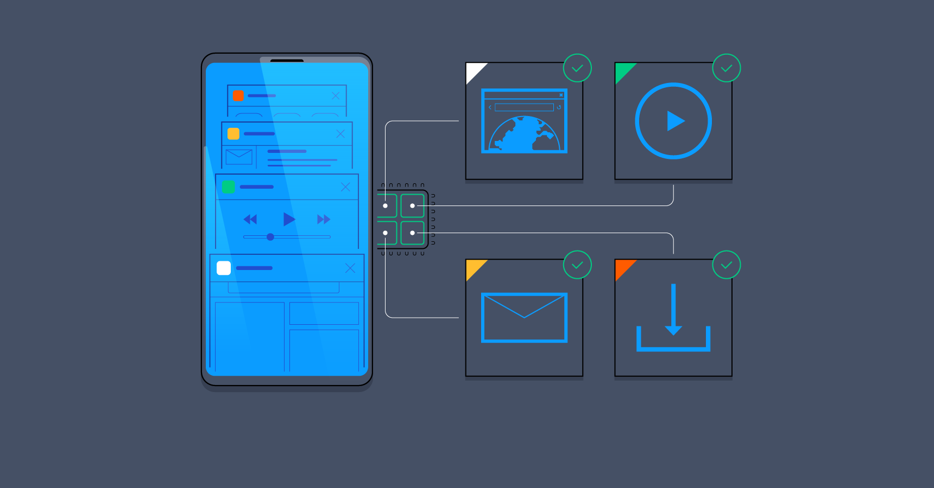
Introduction – Android Application Components
Services
A service is a general-purpose entry point for keeping an app running in the background for all kinds of reasons.

Slide 12
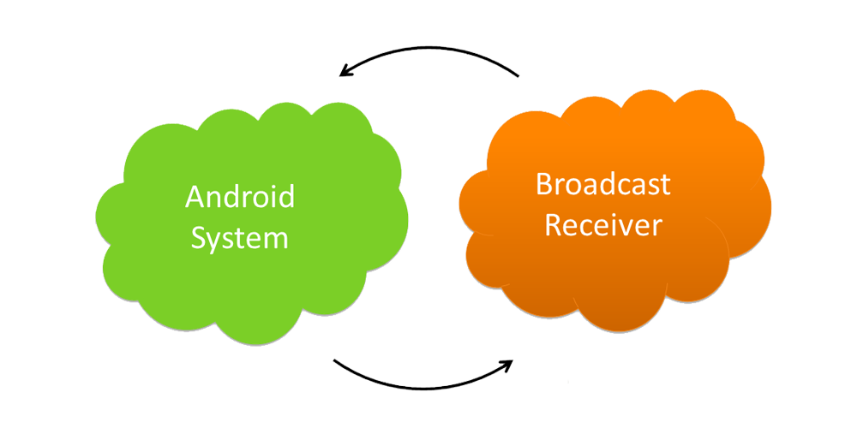
Introduction – Android Application Components
Broadcast receivers
A broadcast receiver is a component that enables the system to deliver events to the app outside of a regular user flow, allowing the app to respond to system-wide broadcast announcements.

Slide 13
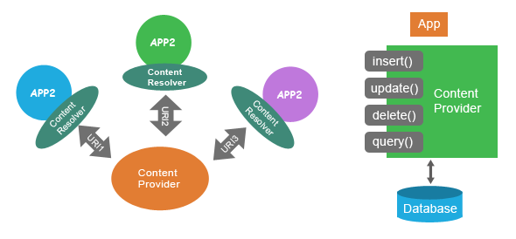
Introduction – Android Application Components
Content providers
A content provider manages a shared set of app data that you can store in the file system, in a SQLite database, on the web, or on any other persistent storage location that your app can access.

Slide 14
Android Studio

Slide 15

Android Studio
Android Studio is the official IDE for Google's Android, designed specifically for Android development.
It is available for download on Windows, macOS and Linux based operating systems. https://developer.android.com/studio

Slide 16
Android Studio
- Create the First Application

Slide 17
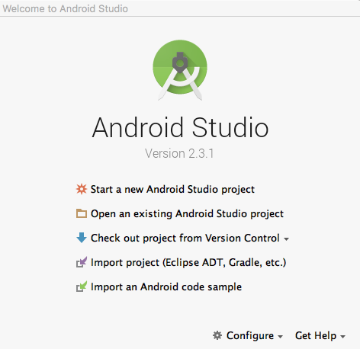
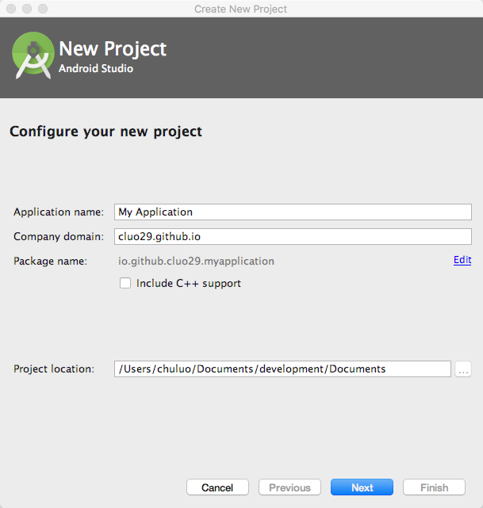
First Example Demonstration

Slide 18
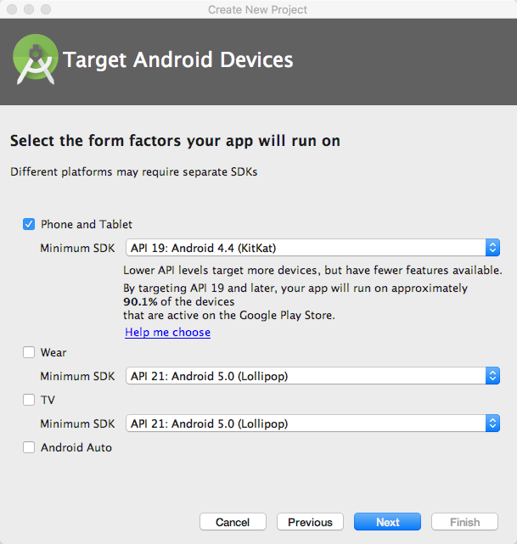
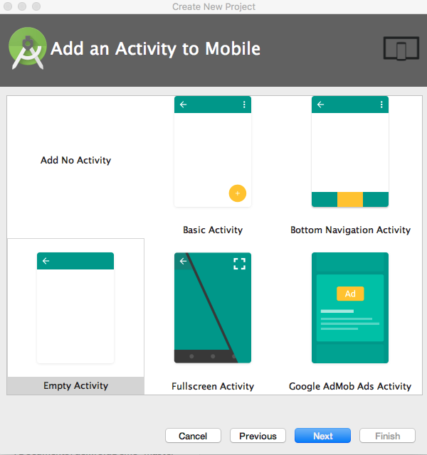
First Example Demonstration

Slide 19
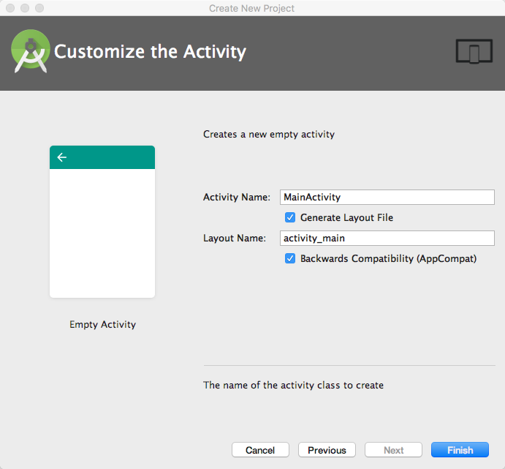
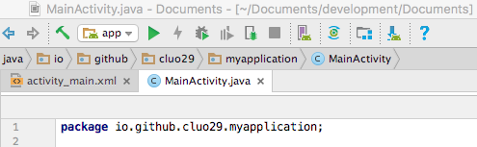
First Example Demonstration

Slide 20
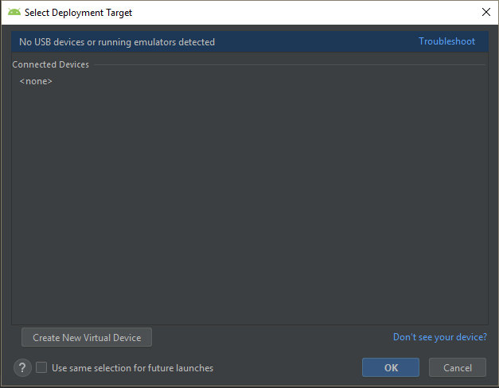
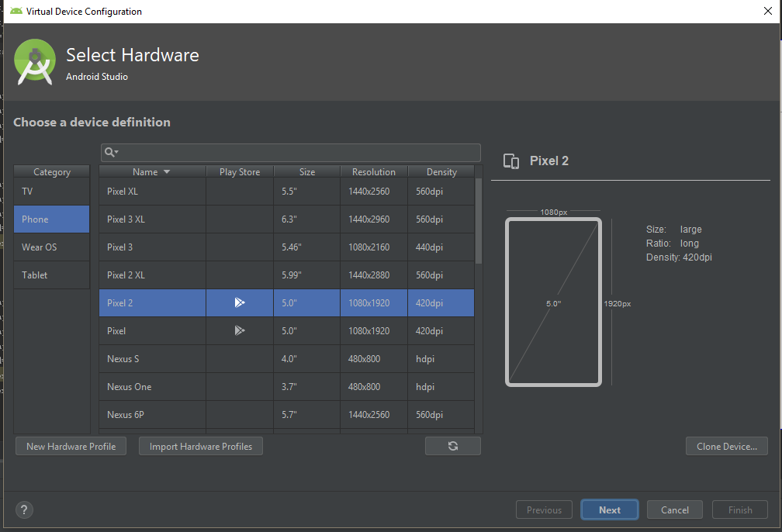
First Example Demonstration
– Virtual Machine (VM)

Slide 21
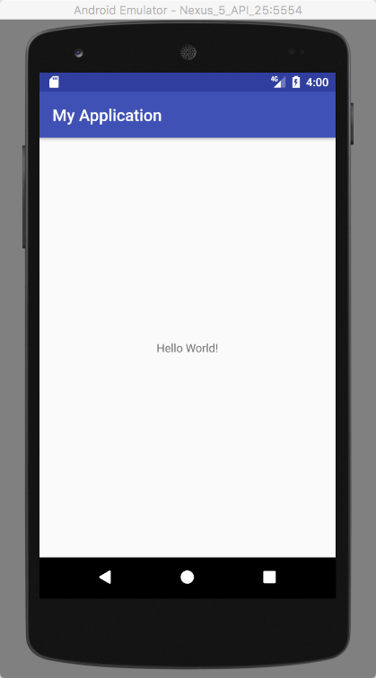
First Example Demonstration
First Application for Android Studio.

Slide 22
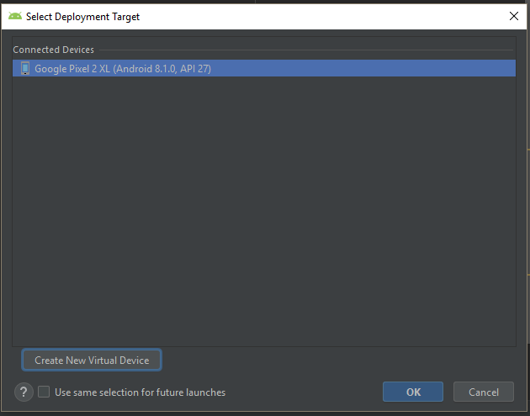
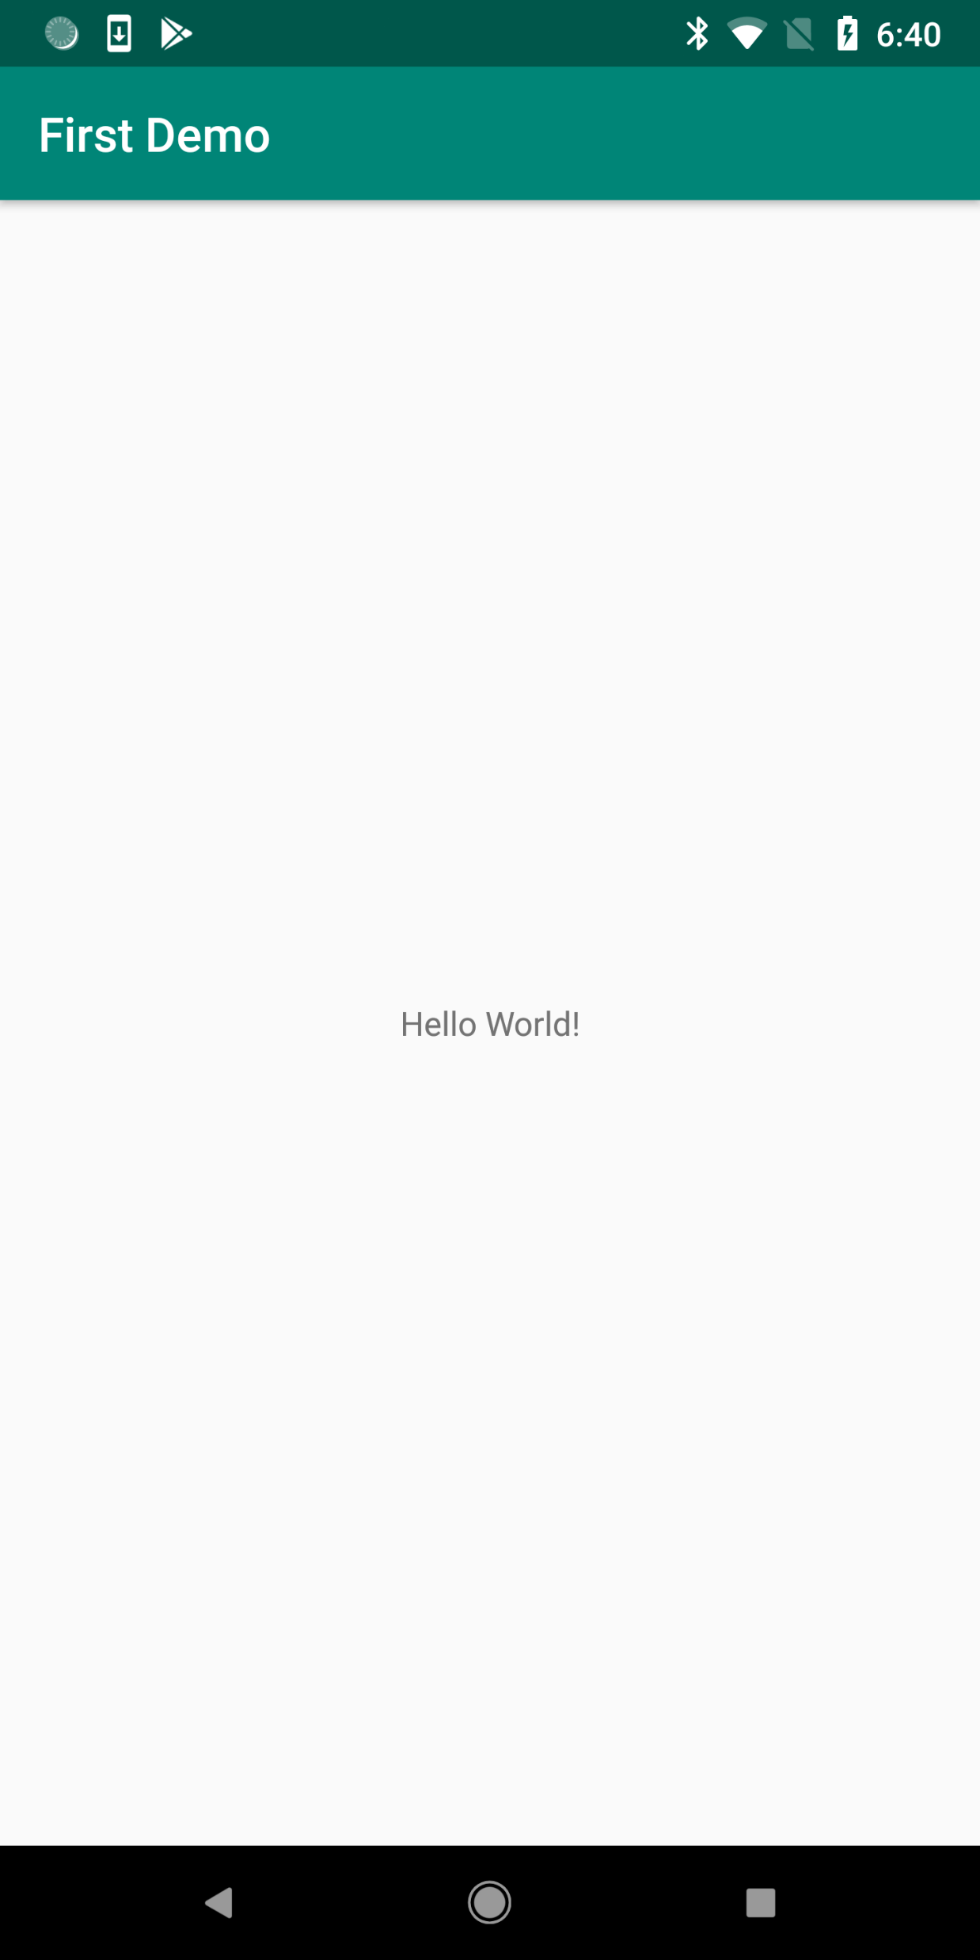
First Example Demonstration
– Android Phone

Slide 23
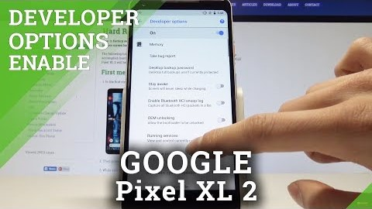
Enable USB Debugging Mode on Android

Slide 24
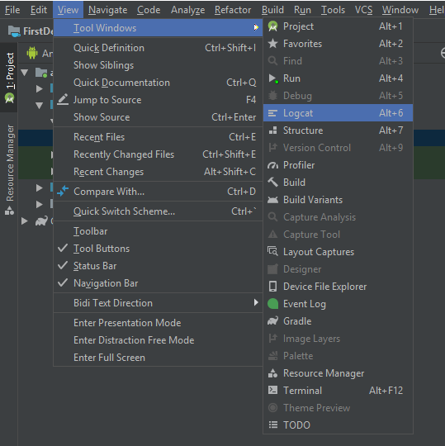
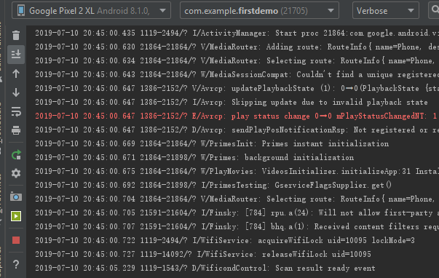
Record Screen from Android Studio
https://developer.android.com/studio/debug/am-video

Slide 25
Android Studio
- Output Log

Slide 26
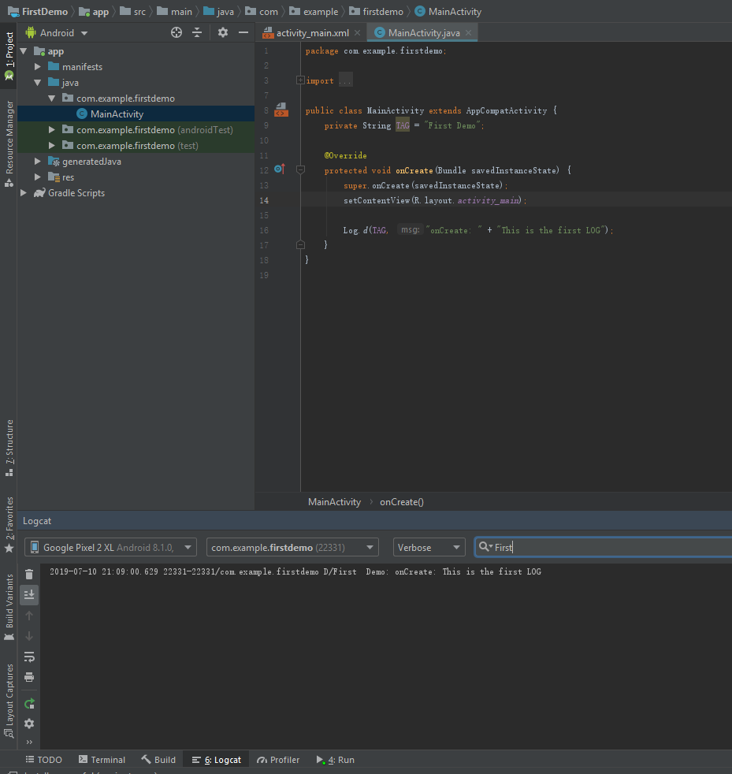

Log in Android Studio
Activity(Java)

Slide 27
Android Studio
- Add Button and Bind Onclick Listener

Slide 28
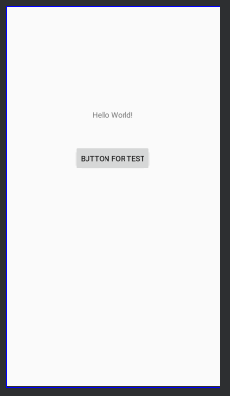
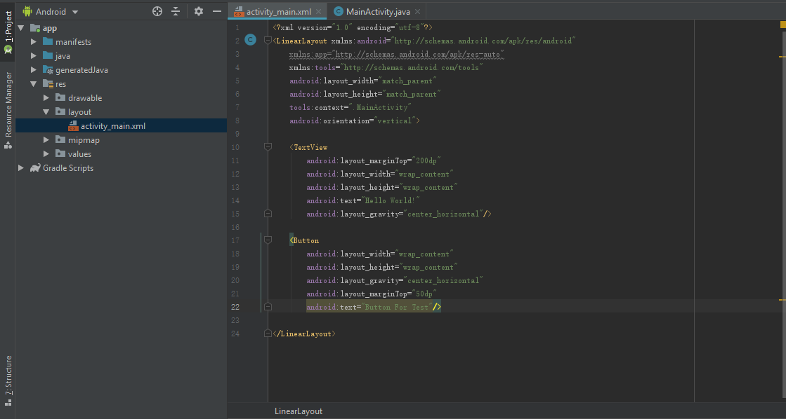
Add a button at the First Activity
Activity(xml)

Slide 29
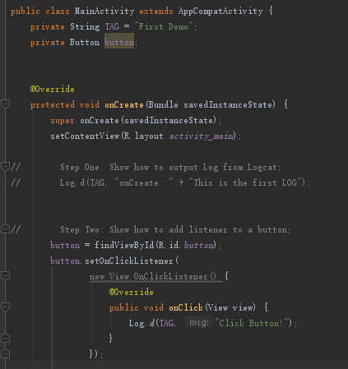

Binding Event to the Button – Native Method
Activity (Java)

Slide 30
Android Studio
- Add button: using a third-party library

Slide 31
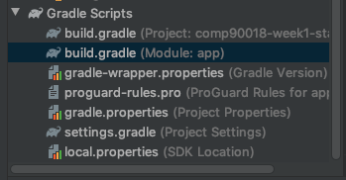
Adding libraries - Gradle
The Android Studio build system is based on Gradle.
The Android Gradle plugin adds several features that are specific to building Android apps.
Project level gradle
App level gradle
https://developer.android.com/studio/build
https://developer.android.com/studio/releases/gradle-plugin

Slide 32
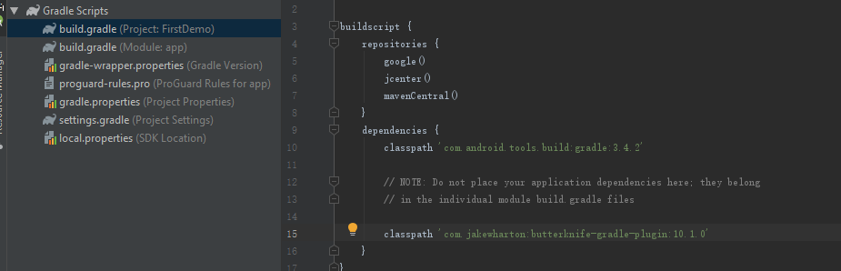
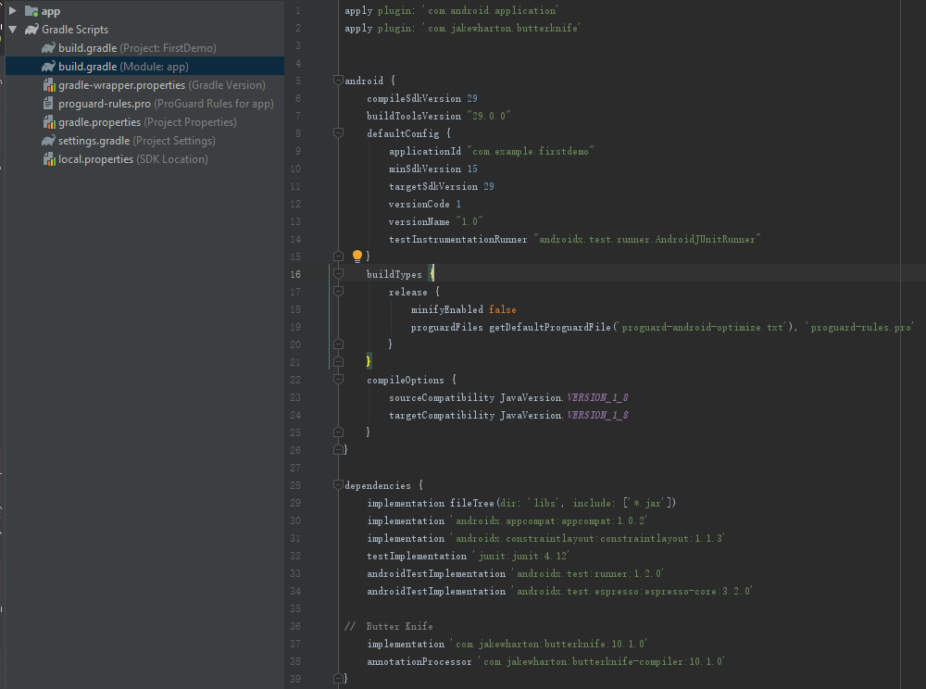
Binding Event to the Button – Butter Knife
build.gradle (project level)
https://github.com/JakeWharton/butterknife
https://jakewharton.github.io/butterknife/
build.gradle (app level)

Slide 33
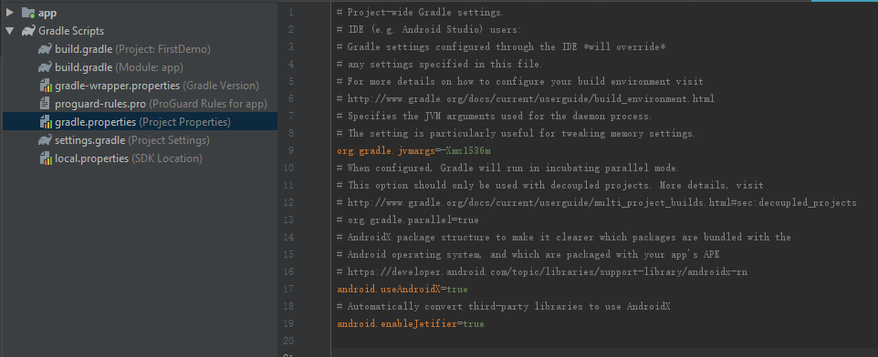
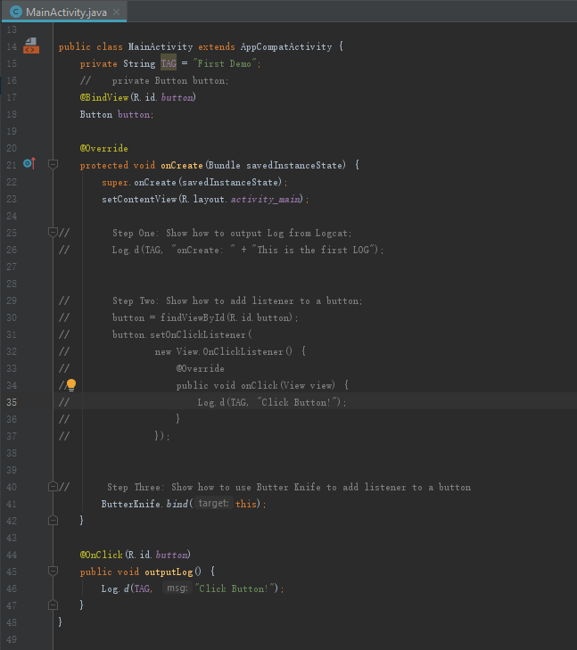
Binding Event to the Button – Butter Knife
gradle.properties
Result
Activity (Java)

Slide 34
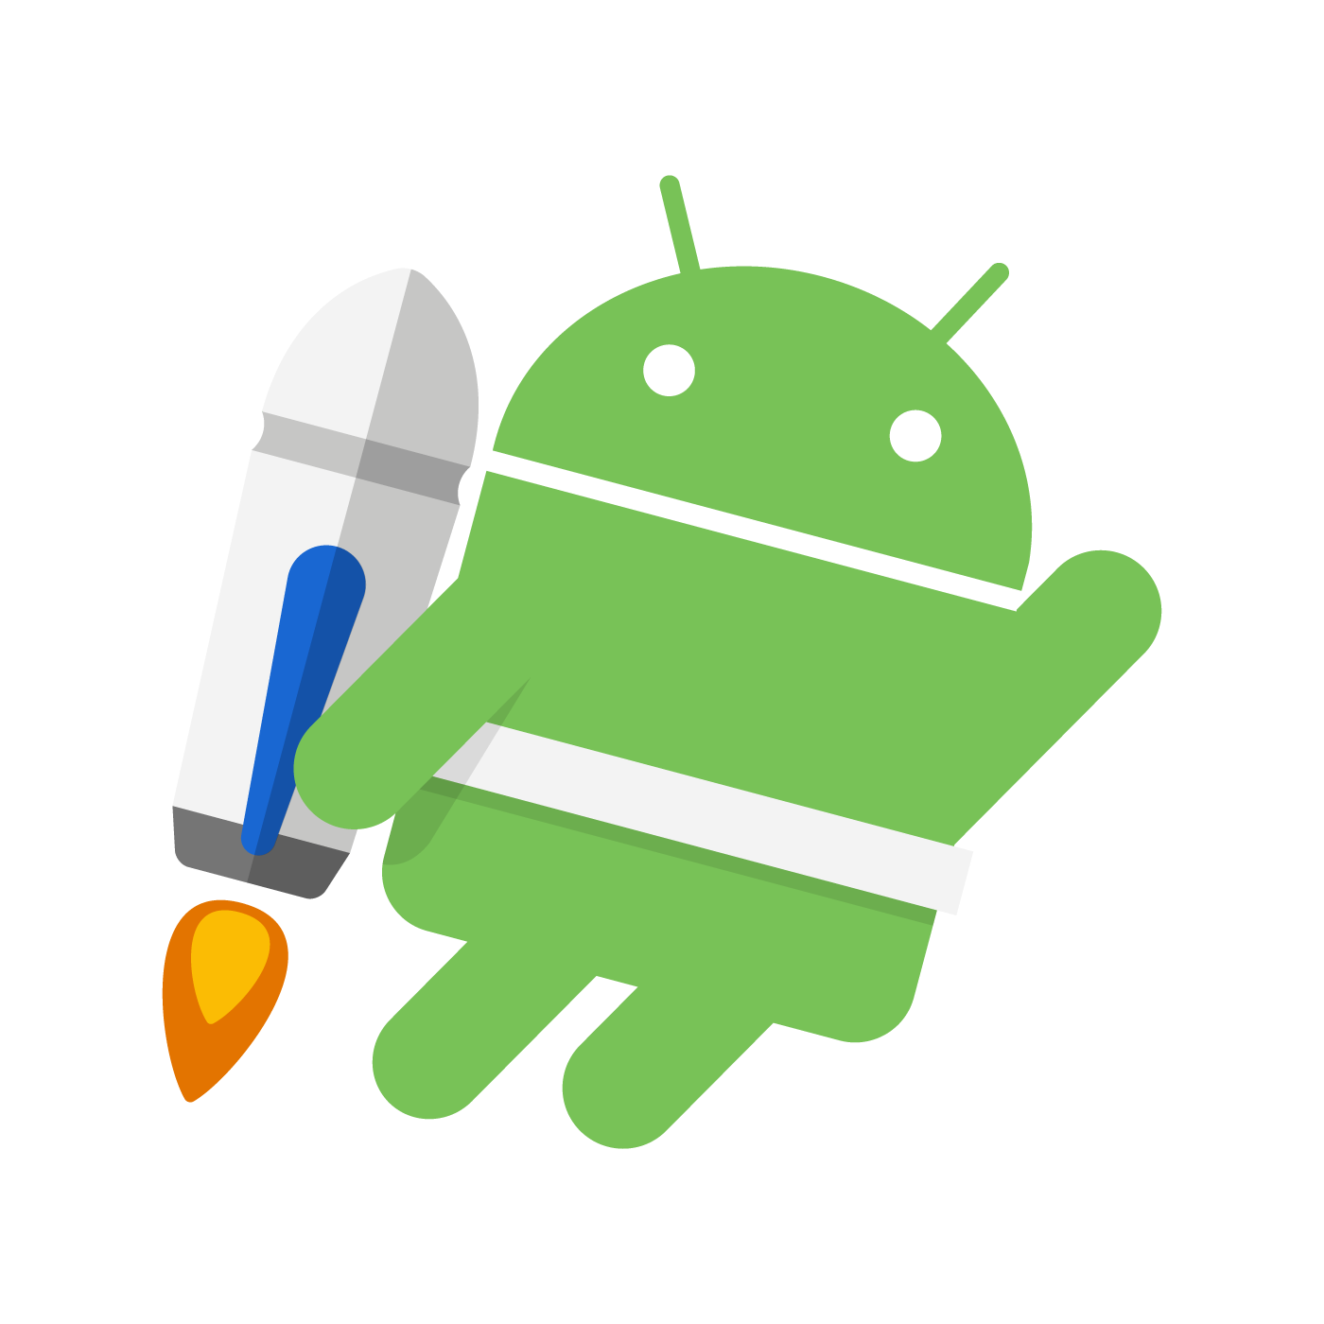
Binding Event to the Button – other methods
View binding
Part of Android Jetpack
  A collection of libraries for best practices
  Keep yourself updated! There are always new tools
  https://developer.android.com/topic/libraries/view-binding

Slide 35
Android Studio
- Create Second Activity

Slide 36
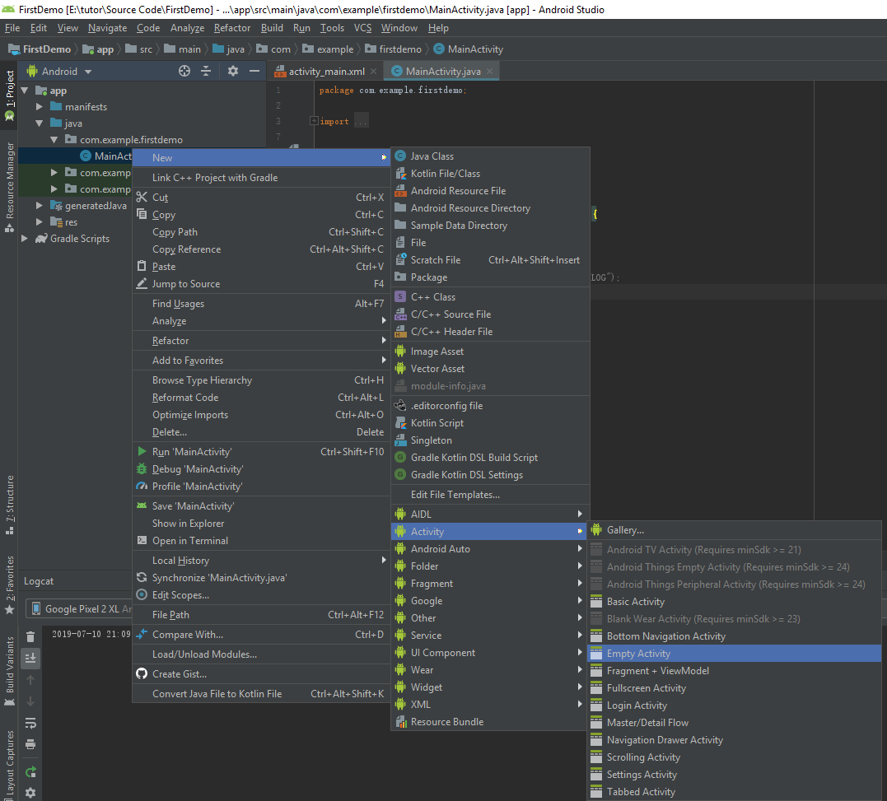
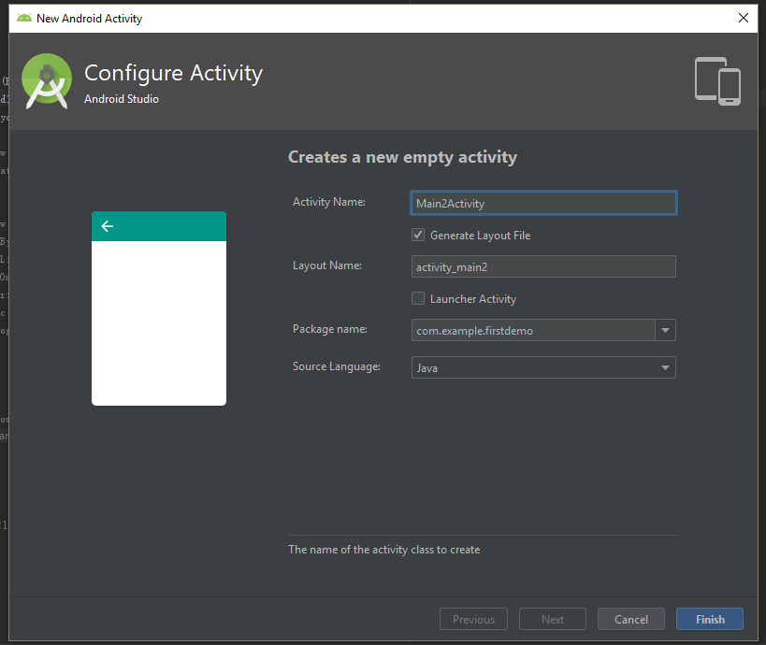
Create the Second Activity

Slide 37
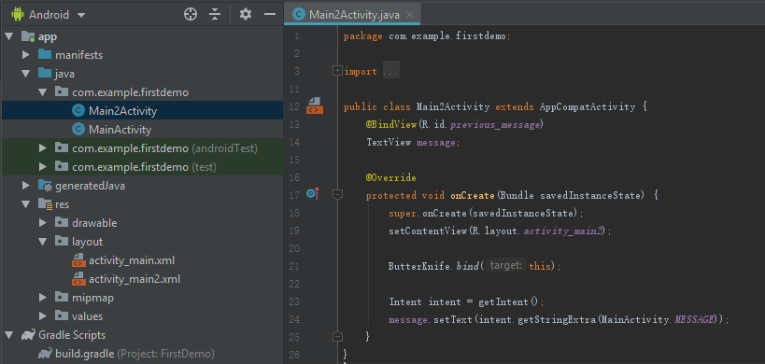
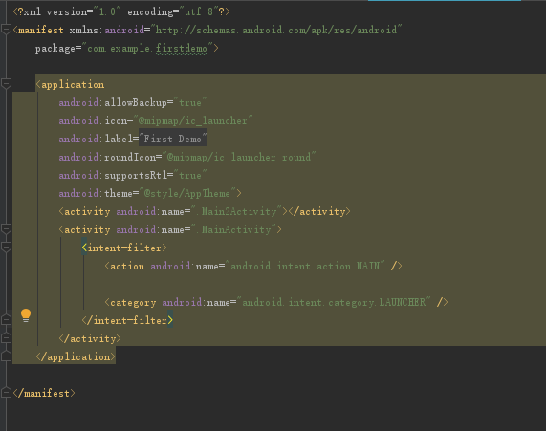
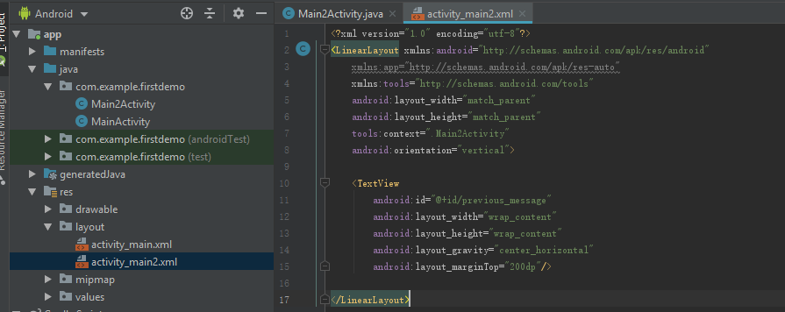
Create the Second Activity
– Generated Scripts
Activity 2 (Java)
AndroidManifest.xml
Activity 2 (xml)

Slide 38
Android Studio
- Communicate between First Activity and Second Activity

Slide 39
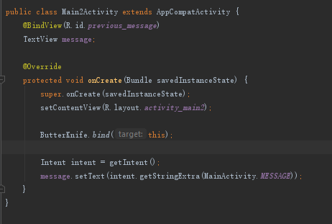
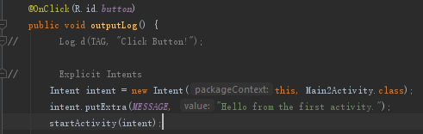
Explicit Intents
Intent: an abstract description of an operation to be performed.
For example: launch an activity during runtime.
Activity 1 (Java)
Activity 2 (Java)
https://developer.android.com/reference/android/content/Intent

Slide 40
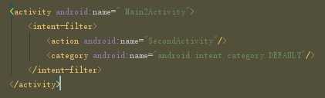
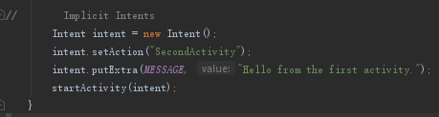
Implicit Intents
AnroidManifest.xml
Activity 1 (Java)

Slide 41
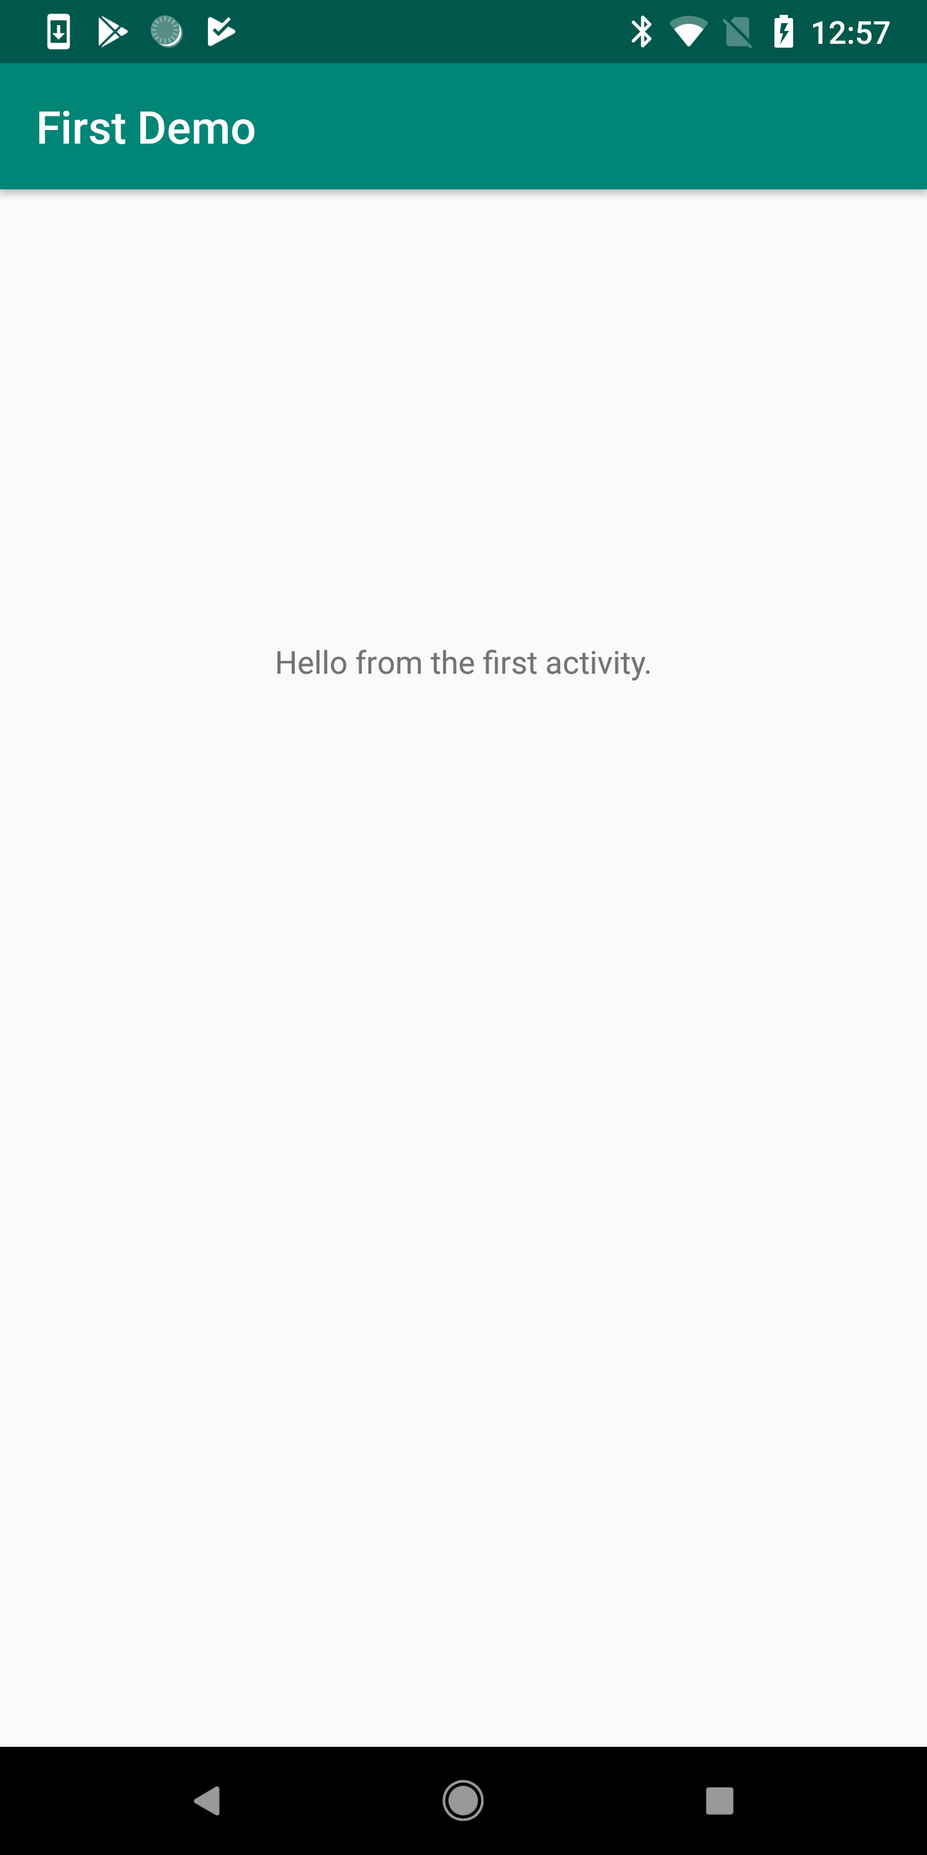
Message from First Activity

Slide 42
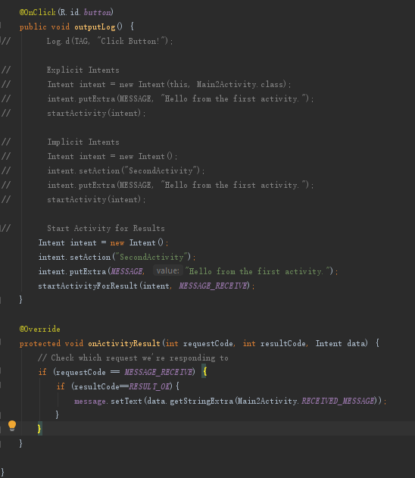
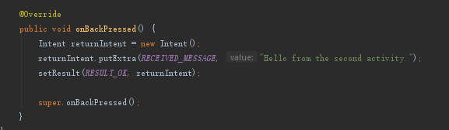
Collect Results from Called Activities
Activity 1 (Java)
Activity 2 (Java)

Slide 43
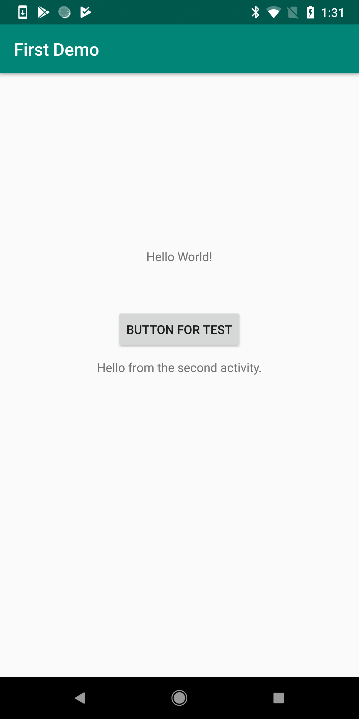
Message from First Activity

Slide 44
For Reading – Intent Filters
Action
A string that specifies the generic action to perform (such as view or pick).
Data
The URI (a Uri object) that references the data to be acted on and/or the MIME type of that data. The type of data supplied is generally dictated by the intent's action. For example, if the action is ACTION_EDIT, the data should contain the URI of the document to edit.
Category
A string containing additional information about the kind of component that should handle the intent.
Information： https://developer.android.com/guide/components/intents-filters

Slide 45
Android Studio
Related Resources
(for reading)

Slide 46
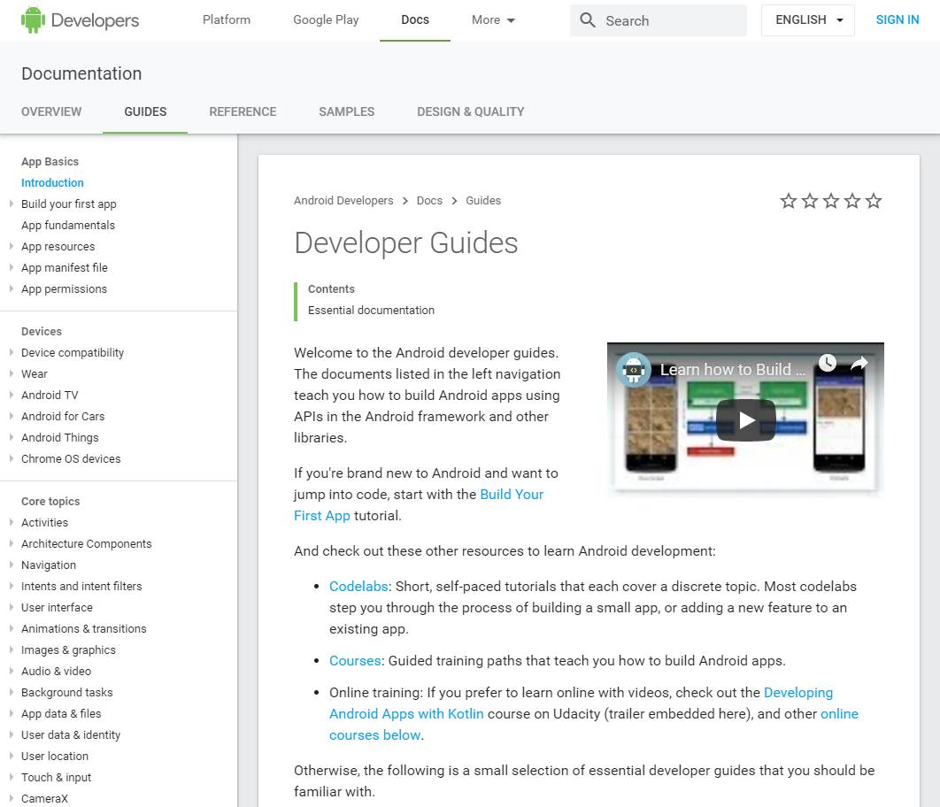
Related Sources – Developer Guides
https://developer.android.com/guide

Slide 47
Related Sources – Android Components
https://developer.android.com/guide/components/fundamentals

Slide 48


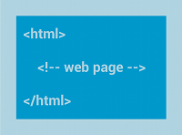



Related Sources – Layouts (next tutorial)
Linear Layout
Relative Layout
Web View
List View
Grid View
Recycler View
https://developer.android.com/guide/topics/ui/declaring-layout
https://developer.android.com/guide/topics/ui/layout/recyclerview

Slide 49
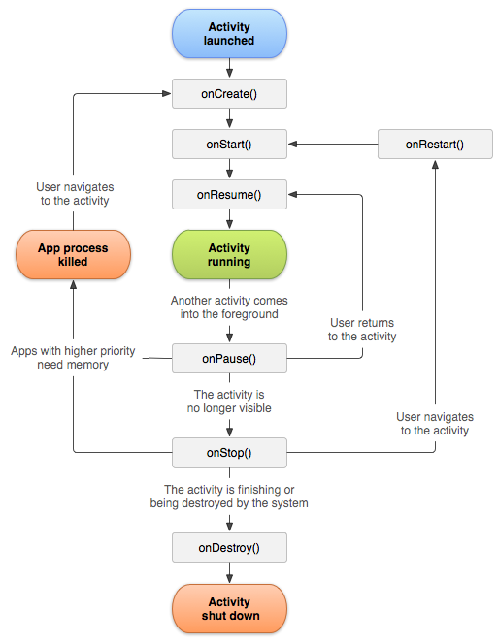

Related Sources – Life Cycle
https://developer.android.com/guide/components/activities/activity-lifecycle
https://developer.android.com/guide/components/fragments

Slide 50




Related Sources – Launch Modes
https://developer.android.com/guide/components/activities/tasks-and-back-stack

Slide 51
Git

Slide 52

Git
Git is a free and open source distributed version control system designed to handle everything from small to very large projects with speed and efficiency.
https://git-scm.com/

Slide 53


Git Installation
https://www.atlassian.com/git/tutorials/install-git
https://github.com/git-guides/install-git

Slide 54

Git Security - SSH keys (recommended)
SSH keys can be used to establish a secure connection with Server for:
when you are performing Git operations from your local machine
when another system or process needs access to repositories in Server (for example your build server)
https://confluence.atlassian.com/bitbucketserver/creating-ssh-keys-776639788.html

Slide 55


Add SSH Keys to Github or Bitbucket
Github
https://help.github.com/en/enterprise/2.15/user/articles/adding-a-new-ssh-key-to-your-github-account
Bitbucket
https://confluence.atlassian.com/bitbucket/set-up-an-ssh-key-728138079.html

Slide 56


Git Init – Github
Git push to remote repository (Command line, for advanced users):
echo "# first-demo" >> README.md
git init
git add README.md
git commit -m "first commit"
git remote add origin https://github.com/ /first-demo.git
git push -u origin master

Slide 57

Git – Basic use case
Update your work to the server
                git add .
                git commit -m “your notes”
                git push
Get updates from the server
git update

Slide 58


Git Push to Remote Repository (Android Studio)

Slide 59


Git Push to Remote Repository (Android Studio)

Slide 60


Git Push to Remote Repository (Android Studio)

Slide 61
Git Tutorial
Git:
https://git-scm.com/docs/gittutorial
Bitbucket:
https://www.atlassian.com/git/tutorials/setting-up-a-repository
Github:
https://try.github.io/

Slide 62
If you come early for the next tutorial,
please re-join the zoom meeting after I end current call.

